Slide 1

Sudoku Solver Using C Programming
Explore the logic-based Sudoku puzzle and dive into the step-by-step implementation of a Sudoku solver using C programming.
By Amal Jyothi S, Kuruvilla George, Rohan Cherian Jacob.

Slide 2

What is Sudoku?
1
Definition
Sudoku is a logic-based, combinatorial number placement puzzle.
2
Objective
Fill a 9x9 grid with digits 1-9 without repetition.
3
Origin
Sudoku originated in the late 19th century and gained popularity in the early 2000s.
4
Difficulty
Varies from easy to hard based on the number of pre-filled cells.

Slide 3
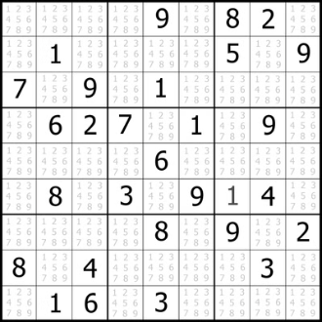
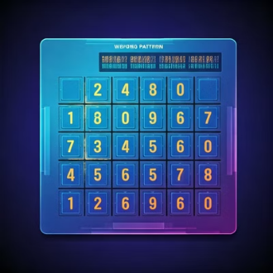

Sudoku Puzzle Example
Example Grid
Rules
Note
A 9x9 Sudoku grid with some pre-filled cells.
Each row must contain numbers 1-9.
Some cells are pre-filled, while others need to be solved.
Each column must contain numbers 1-9.
Each 3x3 sub-grid must contain numbers 1-9.

Slide 4

The Algorithm Behind Sudoku Solving
1
Backtracking
The algorithm uses a brute-force approach known as backtracking.
2
Steps
1. Place a number in an empty cell. 2. Check if it's valid. 3. Move to the next empty cell. 4. Backtrack if no valid number.
3
Efficiency
This approach tries all possibilities and backtracks when necessary.

Slide 5

Code Overview
Objective
Write a C program to read, solve, and determine the difficulty of a Sudoku puzzle.
Key Functions
print, isSafe, solveSudoku, readGridFromFile, determineDifficulty
Approach
Use backtracking to solve the puzzle and categorize it based on difficulty.

Slide 6



Reading and Printing the Sudoku Grid
readGridFromFile
Reads a Sudoku puzzle from a file.
print
Displays the grid in a well-formatted manner.

Slide 7




Checking Validity – isSafe Function
Purpose
Steps
Return
Ensures the number placed in a cell follows Sudoku rules.
1. Check row, 2. Check column, 3. Check 3x3 sub-grid.
1 if valid, 0 if invalid.

Slide 8

Solving the Puzzle – solveSudoku Function
1
Approach
Uses recursion and backtracking to fill each empty cell.
2
Steps
1. Place a valid number. 2. Move to next cell. 3. Backtrack if stuck.
3
Outcome
Solves the puzzle or determines no solution exists.

Slide 9
Determining Difficulty
Function
Criteria
Explanation
determineDifficulty
≤ 20 empty cells: Easy
More empty cells make the puzzle more challenging to solve.
21-40 empty cells: Medium
> 40 empty cells: Hard

Slide 10

Conclusion
Lets Explore Code
Explored Sudoku and implemented a solver in C.

